Slide 1



Character
Character Key actions
Module I: Impact of Character (30 minutes)
Objectives
Self-Assessment – Say Yes or No
Importance of Character: Employee, Leader and Organization
Demonstrate Character - at home, at work, and in your community
Quote to Ponder
Module II: Pillars of Character (30 minutes)
Objectives
Pillars of Character
Case Study Mindset - Treat every person you encounter with dignity and respect
Case Study Mindset - What we think, we become
Quote to Ponder
Module III: Build Your Character (30 minutes)
Objectives
Discussion – Culture & Diversity, Conflict and Unethical behavior
Build Your character – Having, Doing and Being
Character Vocabulary in Communication
Quote to Ponder
Page 1

Slide 3


Core Value: Character
Page 2
Notes:
Do: Conduct introductions as needed.
Say: Welcome to the session for one of our core values, Character. The purpose of this meeting is to explore the importance of character and find areas where we can improve.
Do: Show next slide.

Slide 4
Overview
The RealPage Core Values - Manager Learning Resources aim to help ensure alignment of the core values’ definition throughout RealPage. RealPage leaders and teammates will have thoughtful conversations and engage in helpful activities that will help them embody the core values’ key actions.
Character
Good character builds the trust needed for success. These learning resources aim to help participants develop their character by creating awareness of the areas they can improve on, exploring the importance and pillars of character and providing tools to build character.
Module I: Impact of Character
Character is best shown when no one is watching. This first module aims to help participants take a close look at their actions to realize areas of character that they can or need to improve on. They will also explore the importance of good character as an employee or a leader and to the organization helping them move towards development.
Module II: Pillars of Character Model
In this second module, participants will have a better understanding of what is considered ethical through the four pillars of character. They will also have an opportunity to discuss behavior that they want to improve and how they can do it. Then, through case studies they will determine actions that could improve character.
Module III: Build Your Character
The first two modules focus on self-awareness and understanding the behaviors that comprise good character. In this third module, learners will explore tools to help build their character and to promote good character when communicating with others.
Page 3

Slide 5
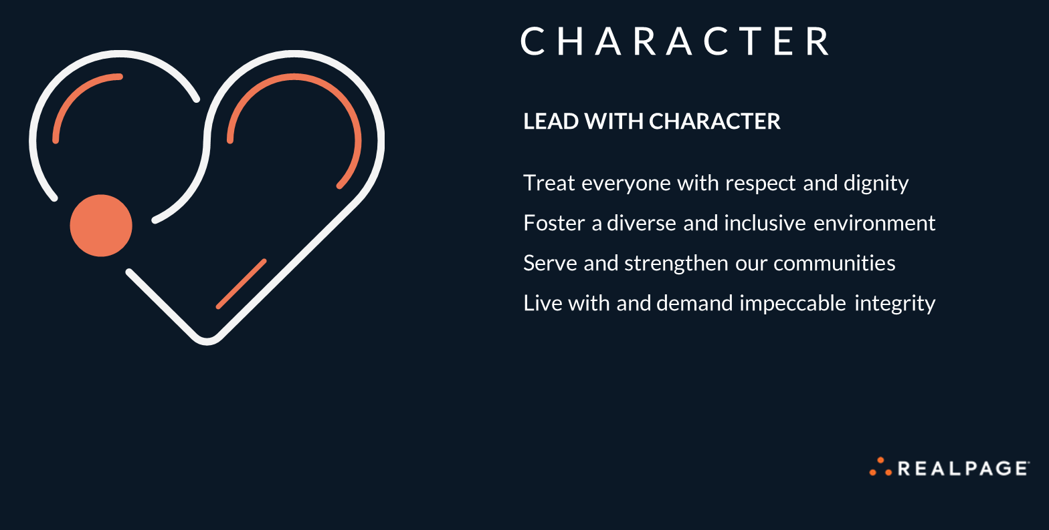
Page 4
Notes:
Say: To start, let’s review the key actions of Character! I’ll give you a few seconds to read through the slide.
Say: Plainly said, character is about showing respect for one another. It’s also being inclusive in the workplace and respecting what everyone brings to the table. Moreover, it’s about making decisions with utmost integrity, and leading with our hearts as we serve the communities where we live and work. That is how we LEAD WITH CHARACTER.
Transition: Let's look at the objectives of today’s session.

Slide 6

Module I
Impact of Character: Objectives
Self-assess on various parameters to determine character improvement areas
Understand the impact of the character core value on oneself, leader and organization
C H A R A C T E R
Page 5
Notes:
Say: In this session, you will take a short self-assessment to determine improvement areas for character. We will also explore the impact of character to employees, leaders and organizations. Let’s start with the self-assessment.
Do: Show next slide.

Slide 7

Self-Assessment
Have you used office supplies for personal use?
Have you ever utilized a leave claiming you were sick, but weren’t?
Do you proactively pitch-in to help meet deadlines of your co-worker?
Do you discuss confidential work matters with friends or family at home?
Have you ever initiated or become part of gossip at work?
Do you multitask during virtual meetings?
Have you ever disclosed information to team members without having complete knowledge on the same?
Do you often express gratitude to your team members or peers?
Do you interrupt your teammates’ ideas/suggestions without listening to the entire plan?
Does your work status show available when you are away?
C H A R A C T E R
Page 6
Notes:
Duration: 5 minutes
Say: Here are 10 questions that will help you be more self-aware of your character and help you identify areas for improvement. Don’t worry, there’s no need to reveal your answers so you can be very candid. I’ll give you 2-3 minutes to answer the questions. You may use a pen and paper to take note of your answers. Let’s begin.
After 2-3 minutes:
Ask: What did you realize upon answering these questions? Would anyone like to share?
Do: Call one or two participants to respond if no one volunteers. Acknowledge, redirect or ask follow up questions, as necessary.
Say: Most of these questions are mundane but even small incidents may jeopardize your character. I’d like to use a quote from William James, an American philosopher, to emphasize this. He said, “Act as if what you do makes a difference. It does.” Irrespective of how small or insignificant a situation may seem, we should always act with integrity for character is best shown when no one is watching.
Transition:
The reason character is so important is because it’s a non-negotiable part of who you are. It tells people how you approach things. Let’s further explore its importance.
Do: Show next slide.

Slide 8




Importance of Character
How is character important under each of the following criteria?
EMPLOYEE
LEADER
ORGANI ZATION
C H A R A C T E R
Employee
Leader
Organization
Page 7
Notes:
Duration: 7 minutes
Say: Character is important for employees, leaders and organizations. As an employee, why does it matter to you?
Do: Acknowledge, redirect or ask follow up questions as needed.
Say: Having good character is important as an employee because it builds the trust needed for success. What you do in situations such as being trusted with confidential information, being in heated conversations, knowing someone is being taken advantage of, etc. speak volumes about you. Hiring managers look for employees with ethical strength because they are reliable and trustworthy.
Good character also affects your relationship with other people. In general, people like to work with others who are honest, dependable and inclusive.
Ask: Now, let’s talk about the importance of character to leaders. Any thoughts?
Do: Acknowledge, redirect or ask follow up questions as needed.
Say: As people managers, having good character can mean being respected by employees in your department. When they know that you will do what’s fair and when they see that you walk the talk and uphold high standards, they will trust you, follow your vision and strive for excellence.
Ask: Now, let’s widen our horizon and discuss why character is important to organizations. Please share your thoughts.
Acknowledge their answers and then say:
Per research, companies and organizations that emphasize integrity and respect in the workplace see an uptick in job satisfaction, loyalty, and productivity, and ensures high employee morale. Clients always look forward to working with organizations where these things exist. This results in consistent revenue generation and a strong position amongst competitors. This also attracts good investors and talents.
Do: Show next slide.

Slide 9


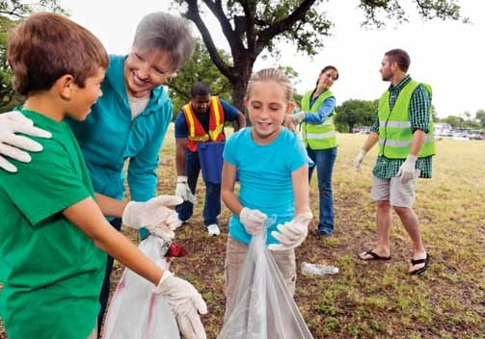
Demonstrate Character
At home
At work
In your community
Page 8
Notes:
Say: Demonstrating good character makes a difference around you. We naturally gravitate and look up to people who inspire us to make a difference in the little and big ways. Can you give some examples of how would you make a difference by demonstrating character?
Do: Acknowledge, redirect or ask follow up questions, as necessary.
Sample answers:
At home:
Treat everyone with respect no matter their age.
Don’t distinguish who will do household work by gender, offer help and take responsibility.
At work:
Don’t discriminate people because of differences in language, color, abilities, etc.
Appreciate and listen to people with different thoughts, ideas, and ways of working.
In your community:
Support the cause in your society and be part of a group or community.
Practice sustainability and encourage others to keep environment clean and safe.
Say: Thank you everyone for sharing your thoughts. I’d like to conclude today’s session with a quote.
Do: Show next slide.

Slide 10
Character is simply habit long continued.
– Plutarch
Page 9
Notes:
Summarize: As we aim to inspire amazing experiences and deliver exceptional value, we have to make sure that individually we develop our character. According to Plutarch, “Character is simply habit long continued.” This means that if you want to change or strengthen your character, you can start by changing your habits. Start by looking at the mundane things that we usually overlook. Be thoughtful about the small decisions you make. As you start with the small things, you will develop good habits that will reap amazing results in the long run.
Do:
- Ask the participants what questions they have and answer the questions.
- Ask for one takeaway from each participant. This can be sent via chat if you need to save time. Acknowledge the takeaways.
Do: Thank everyone for joining the session and highlight some or summarize the takeaways. Let the participants know that you are looking forward to their application in the workplace.

Slide 11
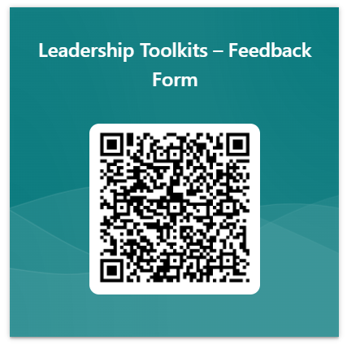
Thank you for using this material! Let us know if this material is helpful.
Feedback QR Code:
Material Feedback link: https://forms.office.com/r/p1UepZ5W1F
Page 10

Slide 12
Thank you.
C H A R A C T E R
Page 11

